Slide 1
Data Pre-processing and Uploading
Oğuzhan Kolay
Training - Workshop
18 October 2024

Slide 2
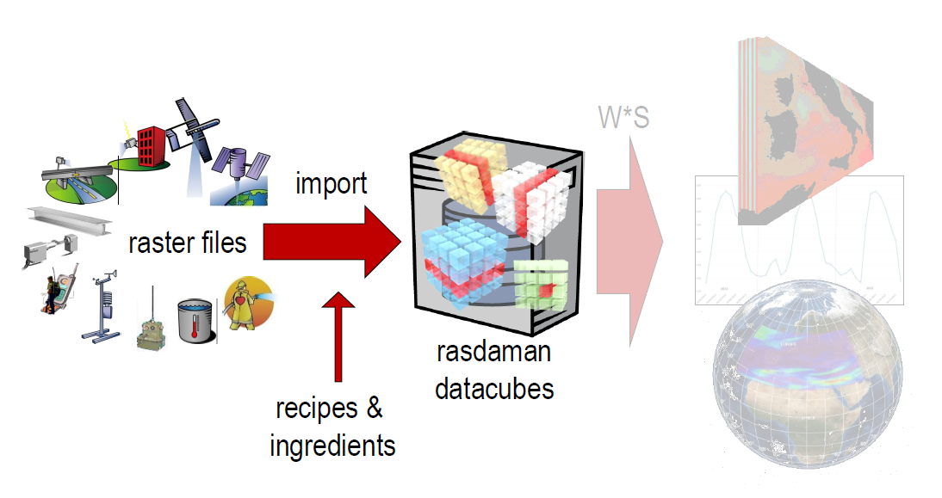
RASDAMAN DATA IMPORT SCHEMATIC PROCEDURE

Slide 3
UPLOADED AND IMPORTED DATA

Slide 4
Global L3C AVHRR Sea Surface Temperature (TEST DATA)

Slide 5
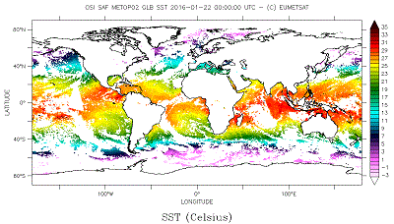
UPLOADED SST DATA
2023-10-20 - 2023-10-29 9 days
Global Metop/AVHRR sub-skin Sea Surface Temperature (GBL SST) is a 12 hourly synthesis on a 0.05° global grid.

Slide 6
MEDICANE WRF MODEL ANALYSIS OUTPUTS

Slide 7
ANALYSED MEDICANE CASE OUTPUTS
1995-01-12 - 1995-01-18 6 days
1996-09-09 - 1996-09-15 6 days
1996-10-04 - 1996-10-10 6 days
2006-09-23 - 2006-09-29 6 days
2023-09-02 - 2023-09-13 11 days

Slide 8
DETAILS OF THE MEDICANE CASE OUTPUTS
Variables:
VAR | DESCRIPTION | UNIT |
SST | Sea Surface Temperature | (K) |
T2 | Temperature at 2m height | (K) |
PSFC | Surface Pressure | (Pa) |
U10 | U-component of wind speed at 10m height | (m/sec) |
V10 | V-component of wind speed at 10m height | (m/sec) |
RAINC | Accumulated total cumulus precipitation | (mm) |
RAINNC | Accumulated total grid scale precipitation | (mm) |
**NOTE #1:** `TOTAL_RAIN = RAINC + RAINNC`
**NOTE #2:** The original spatial resolution of the WRF model run is `9 km x 9 km` and has been interpolated to approximately `5.6 km` (`0.05 degrees`) using cubic interpolation. No information was lost.

Slide 9
DETAILS OF THE MEDICANE CASE OUTPUTS
Grid Features:
FEATURE | VALUE | DESCRIPTION
Dimensions | `(time, lat, lon)` |
Resolution | `1 hour x 0.05 deg x 0.05 deg` | `Spatial = ~5.6 km` |
Latitude | `24.0N - 43.45N` | `(lat_max - lat_min)/0.05 + 1 = 390 rows` |
Longitude | `0.35E - 38.35E` | `(lon_max - lon_min)/0.05 + 1 = 761 cols` |
**NOTE #3:** Some grids contain `NaN` values due to the conversion from the Lambert Conformal projection to the Geographic Coordinate System.

Slide 10
THANK YOU

