Slide 1


ISTANBUL AYDIN UNIVERSITY
Engineering Faculty
Department of Computer Engineering
SEN431 - DATA MINING
Prof. Dr. ZAFER ASLAN
DATA MINING PROJECT:
ANALYZING WIND SPEED DATA SPECIFIC TO THE ULUKISLA REGION

Slide 2


OUR TEAM
Esra Berfin Ertan - B2005.010027
Şevval Nur Kibar - B2105.010110
Merve Çoban - B2005.010076
Emin Gürhan Yıldız - B2105.010080
Sıla Başer - B2005.010037
Sılanur Çiftçi - B2005.010039

Slide 3



INTRODUCTION
  Wind energy is highly sensitive to wind velocity.
  The energy produced by a wind turbine scales with the cube of wind velocity.
  Therefore, wind speed analysis is critical for evaluating energy projects.
  ULUKISLA region data is influenced by factors like atmospheric pressure, temperature, and geographical conditions.
Notes:
Emin

Slide 4

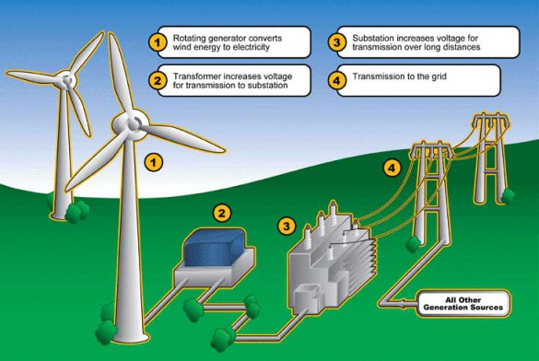

Notes:
Emin

Slide 5

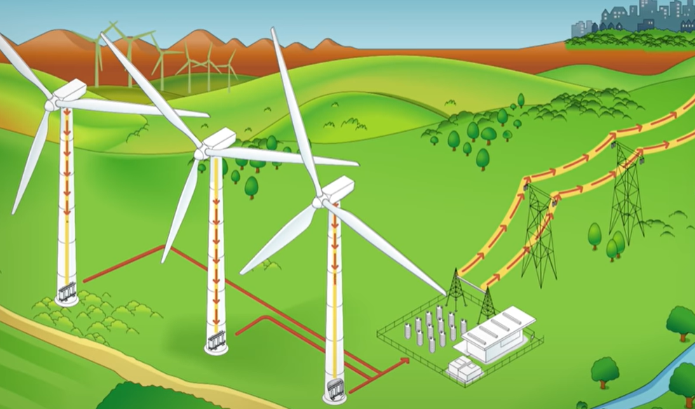
PROBLEMS AND SOLUTIONS
Problem Definition:
Solutions:
  Temporal Variability:
  Seasonal and daily wind speed fluctuations complicate planning.
  Inaccurate Data:
  Missing data points prevent precise analysis.
  Spatial Limitation:
  The dataset focuses solely on ULUKISLA, limiting broader regional insights.
  Feasibility Evaluation:
  Assess whether wind speeds meet the 3–4 m/s threshold required for energy production.
  Statistical Analysis: Calculate mean, median, max/min speeds.
  Time Series Analysis: Identify seasonal wind patterns.
  Machine Learning Models: Develop models to predict wind speeds.
Notes:
Emin

Slide 6

EXPECTED OUTCOMES AND CONTRIBUTIONS
Future Simulations
  Simulate future wind conditions using Artificial Neural Networks (ANN).
Feasibility Assessment
  Compare results with standards like the Weibull distribution to determine project feasibility in ULUKISLA.
Contributions:
  Provide insights into the wind energy potential of ULUKISLA for investors.
  Offer detailed analysis for wind turbine installation and energy planning.
Notes:
Emin

Slide 7


IMPORTANCE OF WIND ENERGY
Why Wind Energy Matters
  Wind energy is a renewable and clean source of power.
  It plays a critical role in reducing reliance on fossil fuels and lowering carbon emissions.
  With increasing global energy demands, wind energy offers a sustainable alternative.
Notes:
Merve

Slide 8


CHALLENGES IN WIND ENERGY
  Unpredictability: Wind speeds can vary significantly.
  Site Selection: Identifying locations with sufficient and consistent wind speeds is crucial.
  Economic Viability: Initial investments depend on precise wind speed data and feasibility studies.
Notes:
Merve

Slide 9


WIND SPEED AND ENERGY POTENTIAL
The Role of Wind Speed
  Energy produced by a wind turbine is proportional to the cube of wind speed:
    Small changes in speed result in significant variations in energy output.
High and steady wind speeds lead to:
    More efficient energy generation.
    Lower operational costs.
80%
Notes:
Merve

Slide 10
METHODOLOGY
DATA PREPROCESSING
MISSING DATA ANALYSIS
  Since no missing data was present, missing data imputation methods were theoretically defined but not applied.
  Theoretical methods included:
  Interpolation: Estimating missing values using surrounding data.
  Time Series Model (ARIMA): Predicting values for continuous missing periods.
  KNN: Estimating categorical or directional data.
NORMALIZATION
ULUKISLA_speed was normalized to a 0-1 range using the Min-Max normalization method.
OUTLIER DETECTION AND REMOVAL
ULUKISLA_speed was normalized to a 0-1 range using the Min-Max normalization method.
DATA CLEANSING
The dataset was cleaned and prepared for analysis. Wind speed units were verified to be in m/s for consistency.
Notes:
esra

Slide 11
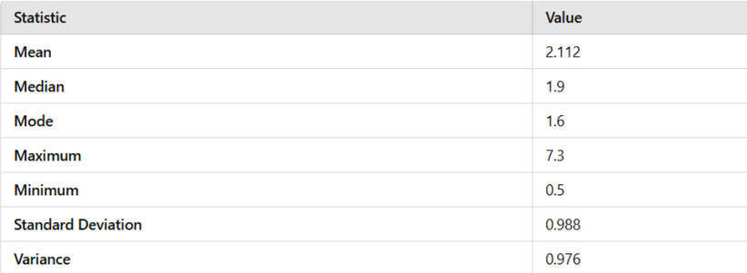
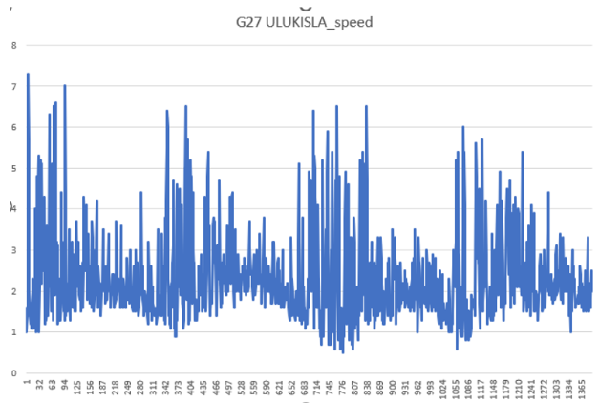
TIME SERIES ANALYSIS OF ULUKISLA_SPEED
DESCRIPTIVE STATISTICS
Key Insights:
  Trend Analysis:
    Long-term wind speed patterns were identified using a rolling mean.
    The data suggests periods of gradual increases or decreases in wind speed.
  Seasonal Pattern Detection:
    Repeating seasonal patterns were observed, highlighting regular fluctuations in wind speed across specific time intervals.
  Anomaly Detection:
    Unusually high or low wind speeds were flagged by comparing actual values to expected values from trend and seasonal components.
Methods Used:
  Rolling mean smoothing was applied to visualize trends and reduce short-term fluctuations.
  Seasonal decomposition (additive model) was performed to separate trend, seasonality, and residual components for detailed analysis.
Notes:
esra

Slide 12
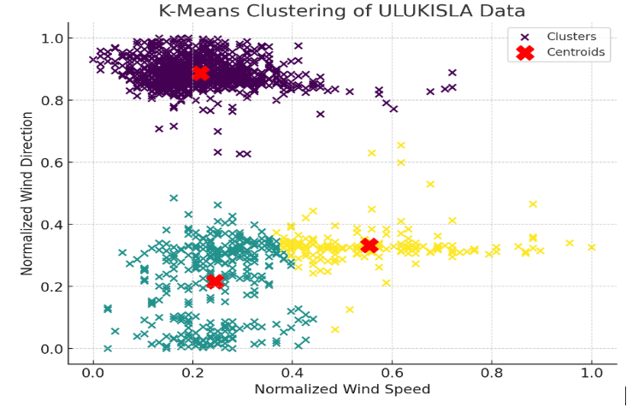
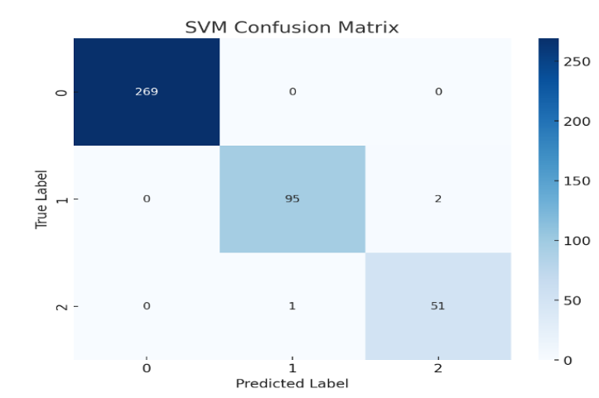
CLUSTERING AND CLASSIFICATION OF ULUKISLA_SPEED
Notes:
esra

Slide 13
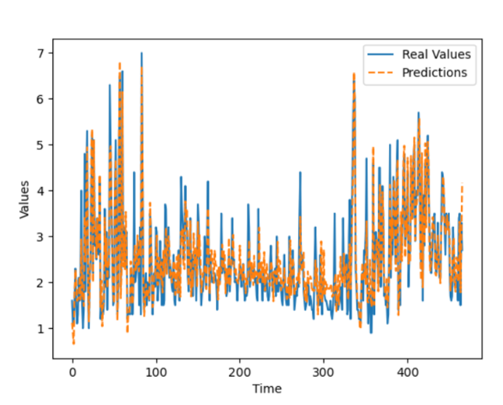
FUTURE SIMULATIONS
  Artificial Neural Networks for Wind Speed Prediction:
    LSTM Models:
      Long Short-Term Memory (LSTM) networks were used to predict future wind speeds.
      LSTM excels at capturing long-term dependencies, making it ideal for time series forecasting.
  Model Details:
    Data Structure:
      Each prediction was based on the previous 10 time steps.
    Architecture:
      The model included one LSTM layer with 128 neurons and a dense layer for output prediction.
    Optimization:
      The Adam optimizer and Mean Squared Error (MSE) as the loss function were used.
    Training:
      The model was trained over 200 epochs with a batch size of 10.
  Results:
  The model successfully predicted future wind speeds by learning temporal patterns in the data.
  Predicted values were compared against actual values to assess performance.
Notes:
esra

Slide 14

DATA ANALYSIS METHODS IN WIND ENERGY
Development of Wind Data Analysis
Artificial Intelligence in Wind Power Forecasting Studies
Multiple Interpolation Methods
Notes:
şevval

Slide 15

Statistical Analysis and Pattern Recognition
Statistical Analysis of Wind Data
Pattern Recognition in Wind Data
  Traditional and Directional Statistics
  Combined Statistical Methods
  Identification of Key Patterns
  Weibull Distribution
  Directional Statistics
  Central Tendency and Variability
  Clustering Analysis (K-Means)
  Time Series Decomposition
  Anomaly Detection
Notes:
şevval

Slide 16

ANALYSIS OF WIND DATA AND RECOMMENDATIONS
Pattern Recognition and Advanced Methods
Data Classıfıcatıon (K-Means Clusterıng)
AI-SUPPORTED ANOMALY DETECTION
SEASONAL AND TIME-BASED DECOMPOSITION
Notes:
şevval

Slide 17
MACHINE LEARNING APPLICATIONS
Wind energy forecasting requires handling vast, complex, and temporal data. Traditional models often struggle to capture these nuances.
Machine learning algorithms, particularly deep learning models like LSTM networks, excel in understanding temporal dependencies in wind patterns.
Combine multiple weak predictors (e.g., linear regressions, decision trees).
Achieves higher accuracy and reduced computational costs.
Suitable for real-world classification and regression tasks.
LSTMs have been widely adopted for tasks like short-term wind power forecasting, leveraging their ability to overcome challenges like gradient disappearance.
Why Machine Learning?
Ensemble Methods
Examples

Slide 18
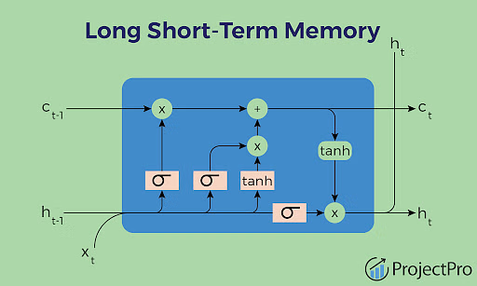
TIME SERIES ANALYSIS
  Statistical Models:
    AR (Brown et al., 1984): Early success in short-term predictions.
    ARMA (Torres et al., 2005): Improved hourly wind speed forecasting.
    ARIMA (Sfetsos, 2002): Effective for 1-hour ahead predictions using 10-minute averages.
  Physical Methods:
    Analytical and empirical approaches.
    Strengths: Simple, reliable for straightforward scenarios.
  NARX Models: Multivariate models outperform univariate ARIMA in wind energy predictions (Cadenas et al., 2016).
  Deep Learning (LSTM): Designed to address limitations of traditional time-series models.
  Excels in extracting meaningful patterns from noisy datasets.
  Applied in various fields like handwriting recognition, object detection, and now wind power forecasting.
  Impact of Modern Methods:
  Higher precision and robustness in short-term forecasting.
  Better suited for dynamic and complex environments.
Traditional Approaches
Modern Techniques

Slide 19
CLUSTERING AND FUTURE DIRECTIONS
  Key Studies:
  Kushwah et al.: Cluster-based statistical modeling for trend detection.
  K. Wang et al.: Combined K-means clustering with deep belief networks for day-ahead predictions, achieving superior performance.
  Transfer Learning:
  Multi-source domain adaptation improves accuracy by leveraging K-means clustering for data weighting and combining insights from multiple sites.
  Hybrid Models: Combining statistical methods (e.g., ARIMA) with machine learning (e.g., LSTM).
  Enhanced Preprocessing: Developing methods to handle noise and missing data more effectively.
  Feature Engineering: Crafting features that better represent meteorological data.
  Integration with NWP Data: Leveraging weather prediction models for longer-term insights.
  Reduced forecasting errors enhance energy grid stability.
  Supports the adoption of renewable energy technologies.
Clustering Techniques
Future Trends and Innovations
Real-World Impact

Slide 20

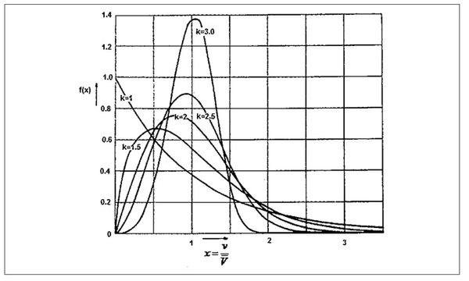
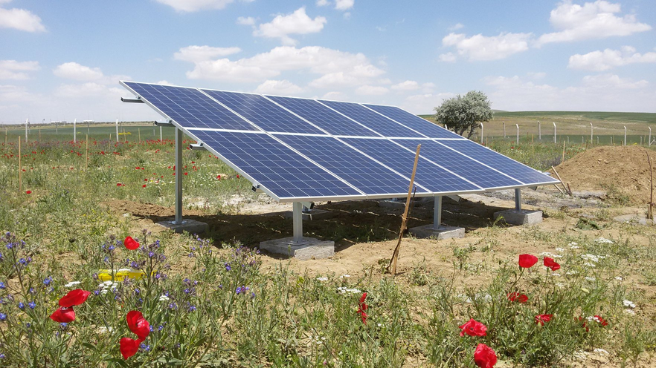
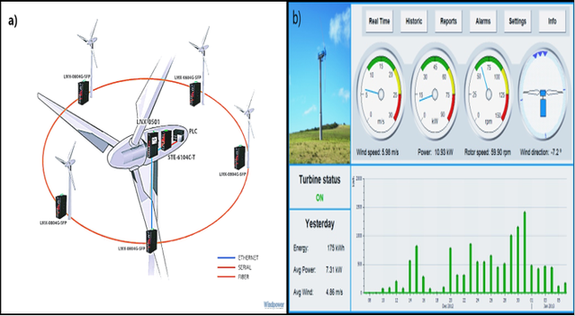
Wind Energy Potential Analysis for the ULUKISLA Region
This study aims to develop sustainable energy solutions by determining the wind energy potential in the ULUKISLA region.
The energy production potential in the region was evaluated through analysis of wind speeds, data processing methods and machine learning models. The study offers solutions to the problems encountered in energy production.

Slide 21
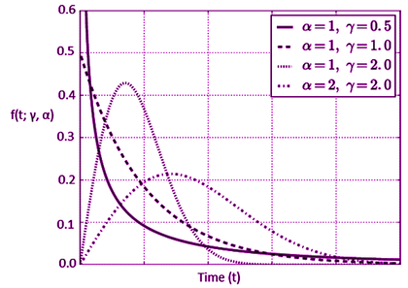
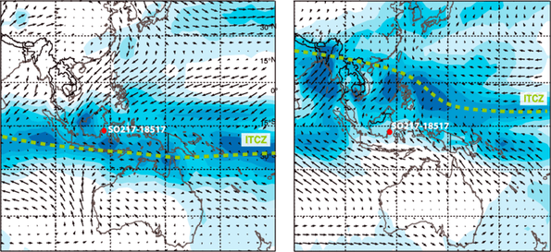
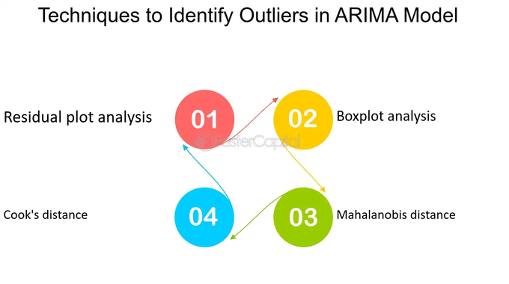
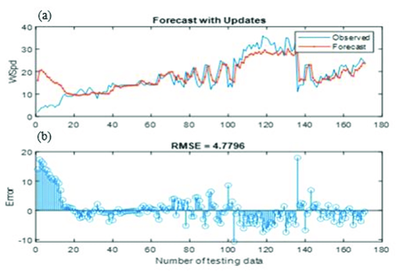
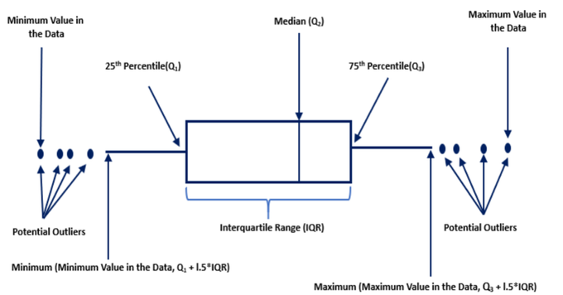
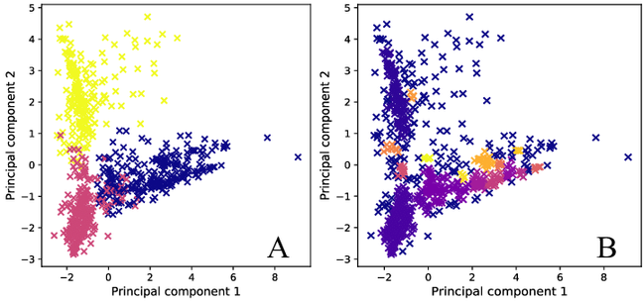
Key Findings and Methods
Findings:
-Seasonal and temporal wind patterns were detected.
-Energy potential was calculated with Weibull distribution parameters.
-Variability in wind speeds revealed the need for energy storage.
Methods:
-Data cleaning with ARIMA and IQR techniques.
-Clustering wind speeds with K-Means and DBSCAN.
-Future wind speed predictions were made with LSTM models.

Slide 22
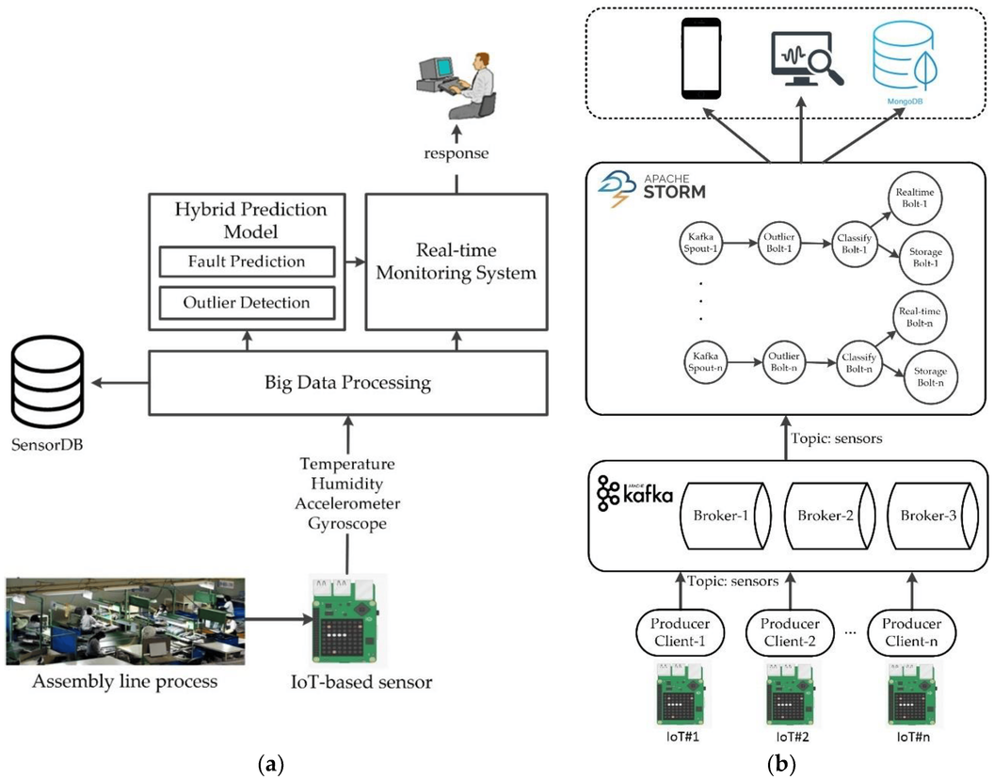
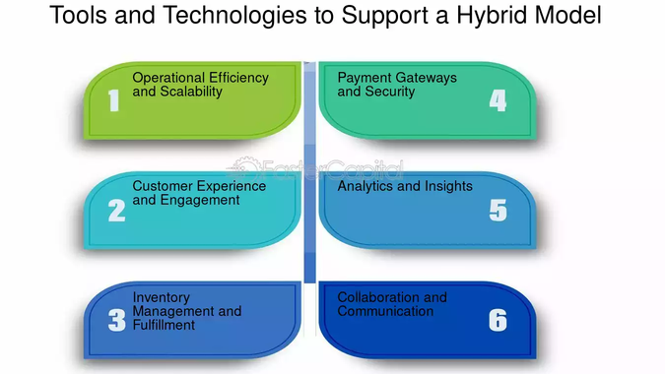
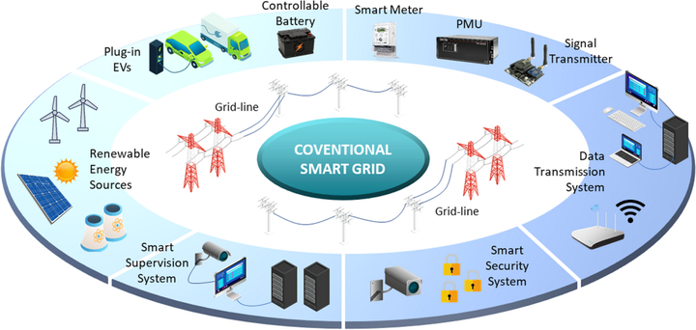
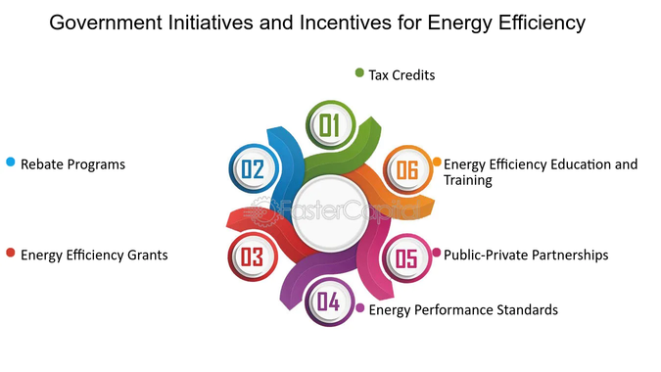
Applications, Limitations, and Recommendations
Applications:
-Data-driven solutions were offered for turbine placement strategies and energy production planning.
-Guidance for sustainable energy incentives was provided for policy makers.
Limitations:
-The study is based only on local data.
-Economic feasibility analyzes are not included.
Suggestions:
-Improving analytics with larger data sets and real-time IoT systems.
-Integration of hybrid modeling and economic evaluations.

Slide 23
Thanks For Listening

