Slide 1
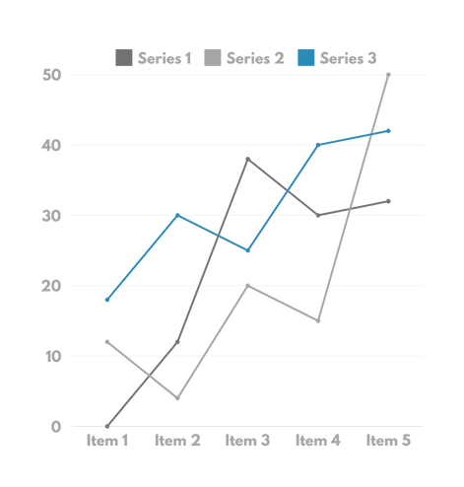


KORKUTELİ WIND DATA ANALYSIS

Slide 2

INTRODUCTION
Analyzing KORKUTELİ wind speed data for renewable energy utilizationthrough data mining techniques
  ANALYZES HISTORICAL WIND SPEED DATA.
  Identifies patterns and trends.
  Predicts future wind behavior to assess feasibility for renewable energy projects

Slide 3

PROBLEM STATEMENT:
Wind energy is a significant renewable energy source, but its feasibility heavily depends on consistent and predictable wind speeds

Slide 4

AIM OF THE PROJECT
  Understand wind speed patterns.
  Simulate future scenarios.
  Assess potential for energy projects.

Slide 5

GENERAL REVIEW OF LITERATURE
•WIND ENERGY POTENTIAL:
Studies highlight Turkey's potential for wind energy.
• DATA MINING IN WIND ENERGY:
Effective in uncovering hidden patterns and forecasting trends
•REGIONAL STUDIES:
Provide insights for renewable energy initiatives.

Slide 6
METHODOLOGY OVERVIEW
DATA PREPROCESSING
  COLUMN IDENTIFICATION:
Focused on 'KORKUTELİ_wind Speed
• MISSING DATA:
REPLACED ONE MISSING VALUE WITH THE MEAN (1.11 M/S).
  STANDARDIZATION:
Applied z-score formula for clustering and classification.

Slide 7

METHODOLOGY OVERVIEW
TIME SERIES ANALYSIS
  TREND ANALYSIS:
Rolling averages revealed consistent wind speed patterns
  FORECASTING:
ARIMA model predicted stabilization around 1.13 m/s.
  SEASONALITY:
Repeating monthly cycles identified through decomposition.
  VISUALIZATIONS
Time Series Plot, Decomposition Plots (Trend, Seasonal, and Residual components)

Slide 8
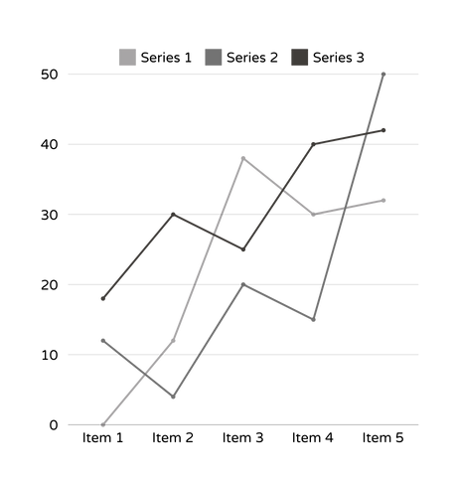
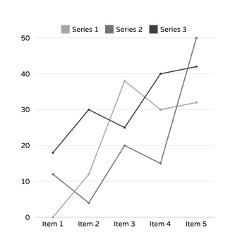
METHODOLOGY OVERVIEW
CLUSTERING AND CLASSIFICATION
  CLUSTERING:
K-means identified three categories (low, medium, high).
  CLASSIFICATION:
Thresholds were applied to classify wind speeds into predefined categories, confirming cluster distributions.

Slide 9
SIGNIFICANCE OF THE STUDY
  Evaluates KORKUTELİ's renewable energy potential.
  ENVIRONMENTAL BENEFITS:
Reduces carbon emissions.
  ECONOMIC BENEFITS:
Lowers energy costs, and promotes sustainability.

Slide 10
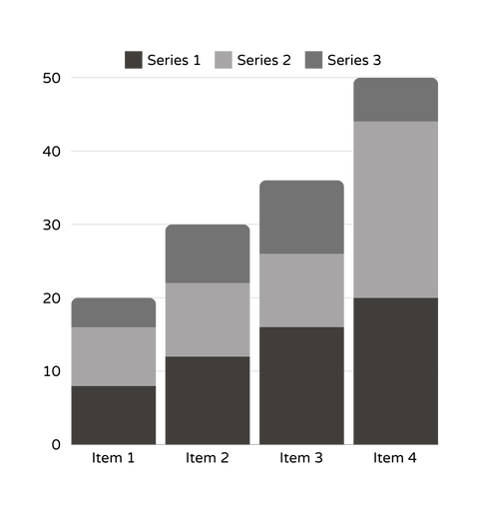
ASSUMPTIONS AND LIMITATIONS
Assumptions
  Dataset represents typical wind conditions.
  No abrupt climate changes.
LIMITATIONS
  Limited dataset timeframe.
  Excludes policy and market dynamics.

Slide 11
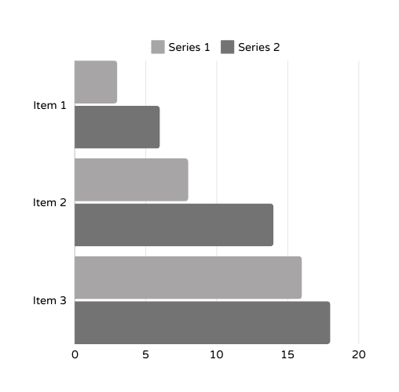
PRACTICAL RECOMMENDATIONS
  SEASONAL OPTIMIZATION:
Focus on peak wind seasons for energy generation to maximize output.
  TURBINE SELECTION:
Employ turbines designed for moderate wind speeds to optimize efficiency.
  POLICY IMPLICATIONS:
Encourage local policymakers to consider wind energy incentives in KORKUTELİ.

Slide 12
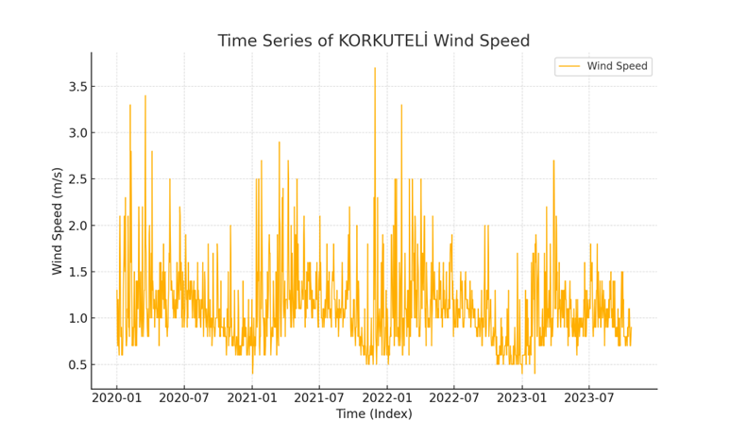
TIME_SERIES_KORKUTELI_WIND_SPEED.

Slide 13
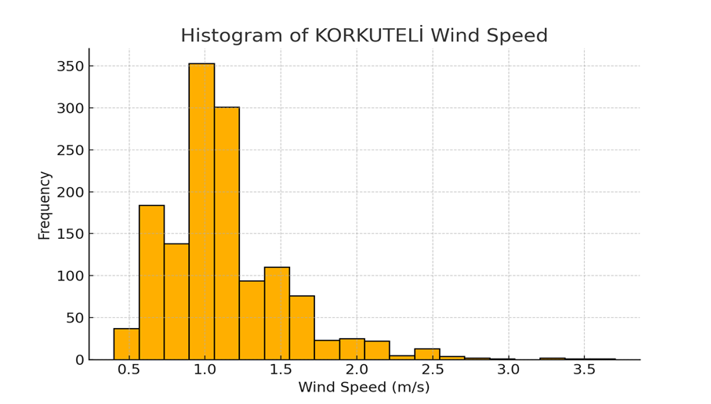
HISTOGRAM_KORKUTELI_WIND_SPEED.

Slide 14
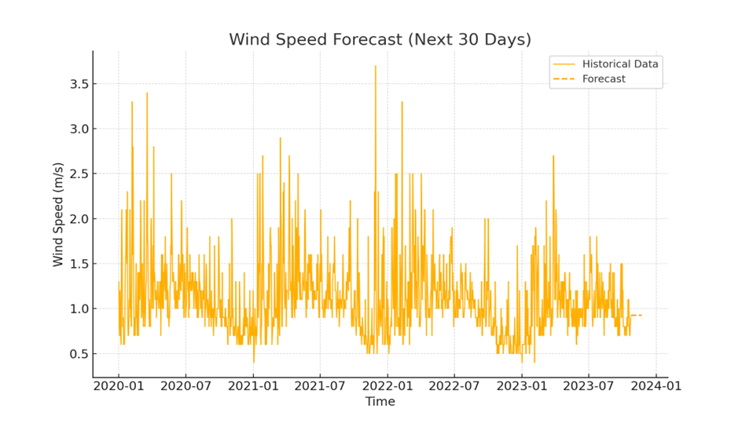
FORECAST_KORKUTELI_WIND_SPEED

Slide 15
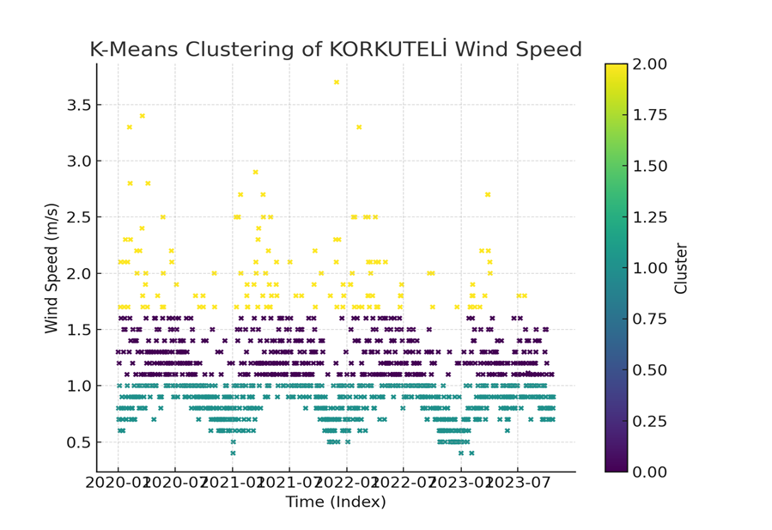
CLUSTERING_KORKUTELI_WIND_SPEED.

Slide 16
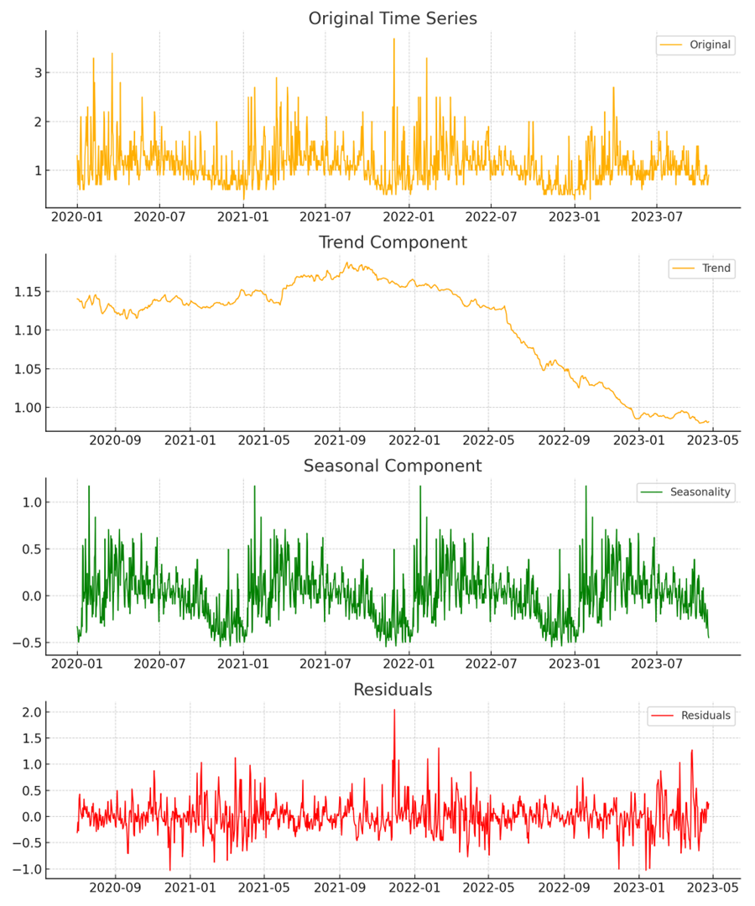
DECOMPOSITION_PLOTS_KORKUTELI

Slide 17
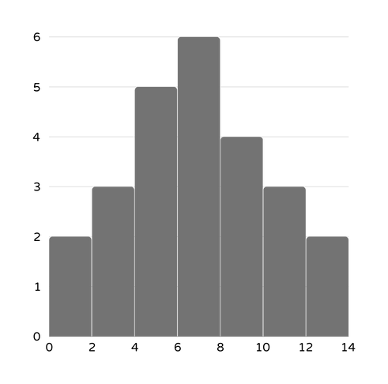
REFERENCES
- Dağtekin and Yelmen (2022). Wind energy potential in Mersin province.
- Arslan (2015). Statistical analysis of Turkey’s wind energy potential.
- El-Halees (2015). Data mining applications in wind energy analysis.
- Reddy and Reddy (2019). Estimating wind speed using data mining techniques.
- Gönül et al. (2021). Turkey’s wind energy market and policies.

