Slide 1

DATA MINING AND
WIND ENERGY
-MUT-
Ali Abdulwahab Nur Abdi Ali Abdulwahab / B2005.010133
Khabibullakh Alibekov / B2105.010020
Mohammed Islam Haji / B2205.010022
İbrahim Ulvi Mercan / B2005.010014
Hajar Said / B2105.010046
Mohammad Rashid Abdulmunem Al-dabooni / B2105.010047

Slide 2



Introduction
Wind Energy
•Wind energy; addressing variability, data gaps, and inefficiencies is key to enhancing its reliability and sustainability.
•Exploring how machine learning enhances wind energy systems by improving prediction, optimization, maintenance, and site selection for greater reliability and sustainability.

Slide 3


Introduction
Project Overview
This Project aims to present the use of machine learning in the wind energy system and the problems such as wind speed prediction, energy, and turbine efficiency. As with other studies, the report considers the ways in which machine learning increases reliability and sustainability of wind energy in terms of forecasting, maintenance, and site selection to support a future filled with renewable energy sources.

Slide 4
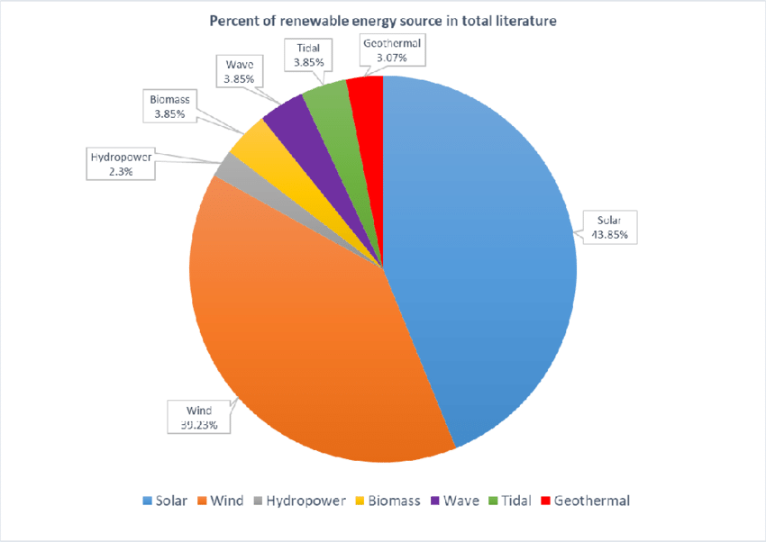
Literature Review
Wind Energy and Its Global Role
  Global Significance:
    Wind energy is central to reducing reliance on fossil fuels.
    Addresses growing energy demands sustainably.
  Key Challenge – Variability:
    Intermittent wind speeds lead to inconsistent energy output.
    Advanced models and technologies are required for optimization.
  Solutions to Variability:
    Predictive models using machine learning for better wind speed forecasting.
    Geographical aggregation of wind farms reduces energy output fluctuations.

Slide 5
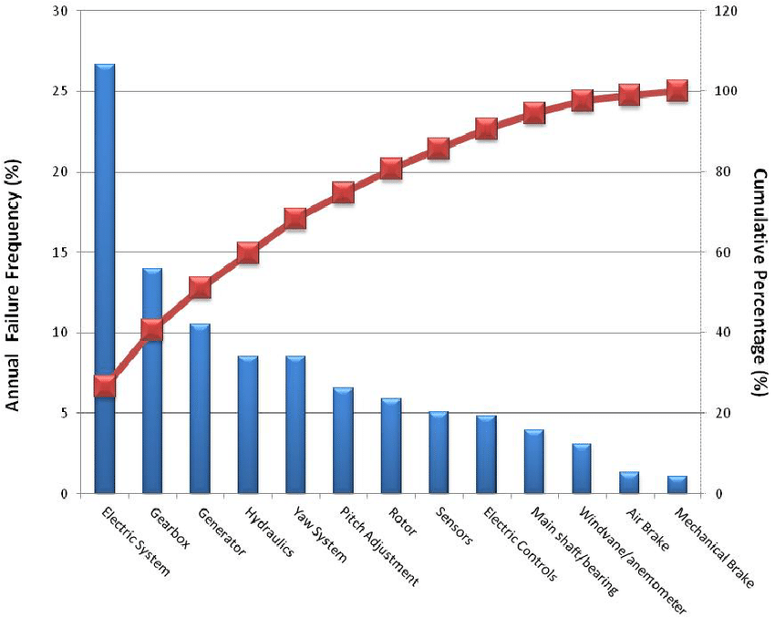
Literature Review
Innovations in Turbine Technology
  Enhanced Turbine Designs:
    Advanced blade materials improve efficiency and durability.
    Active pitch control optimizes performance across varying wind speeds.
  Role of AI and Machine Learning:
    Predictive maintenance detects faults early, reducing downtime.
    Real-time optimization of turbine operations boosts energy yield.
  Future Potential:
    Continuous innovation needed for scalability and sustainability.

Slide 6



Methodology
Data Preprocessing
1) Dealing with Missing Data:
  Only one missing data: Linear interpolation
  Multiple consecutive missing data: 2nd order polynomial interpolation
2) Data Cleaning & Preparation:
  Unused columns were dropped

Slide 7

Methodology
Descriptive Statistics
Sample Count | 1392 days
Mean Wind Speed | 2.15 knots
Median Wind Speed | 1.9 knots
Mode Wind Speed | 1.9 knots
Minimum Wind Speed | 0.3 knots
Maximum Wind Speed | 6.8 knots
Variance | 1.36
Standard Deviation | 1.16

Slide 8
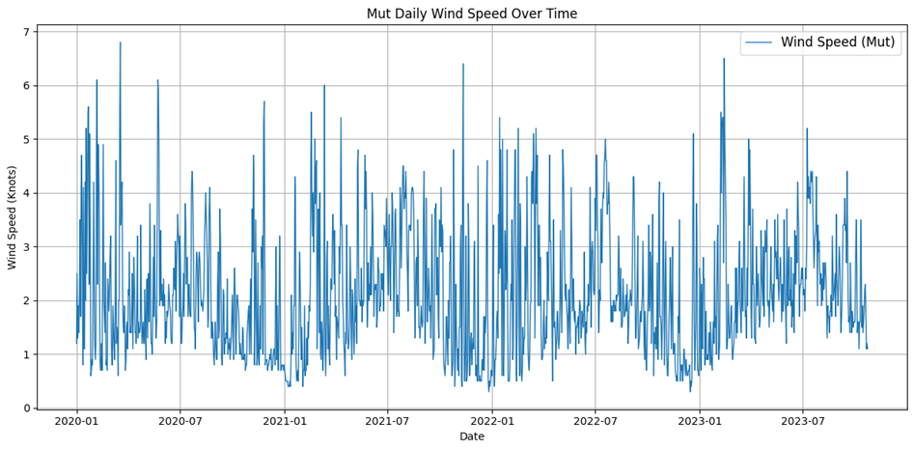
Methodology
Time Series Analysis

Slide 9
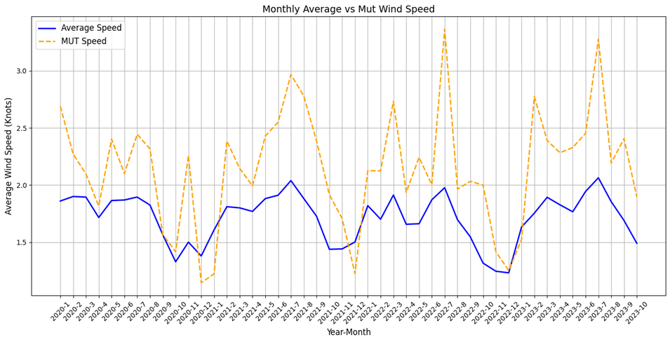
Methodology
Time Series Analysis

Slide 10
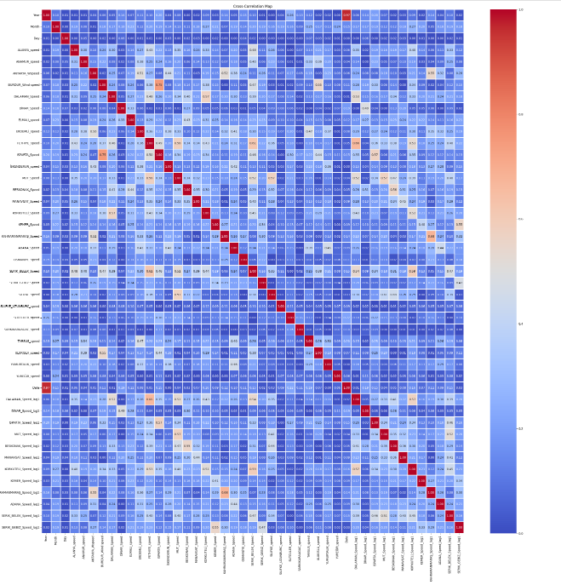
Methodology
Feature Selection
1) Lagged features were generated
2) Correlation map is used to decide which features to be used

Slide 11
Methodology
Feature Selection
DALAMAN_Speed_lag1 | 0.52
BESKONAK_Speed_lag1 | 0.47
KORKUTELİ_Speed_lag1 | 0.39
MUT_Speed_lag1 | 0.57
Year | 0.08
Month | 0.13
Day | 0.00
MUT_Speed | 1

Slide 12
Methodology
Feature Selection
3) Season feature is added according to the month
  Wind speed might be season dependent
4) Cyclical encoding for month feature is added
  Shows periodic data
  Preserves continuity

Slide 13
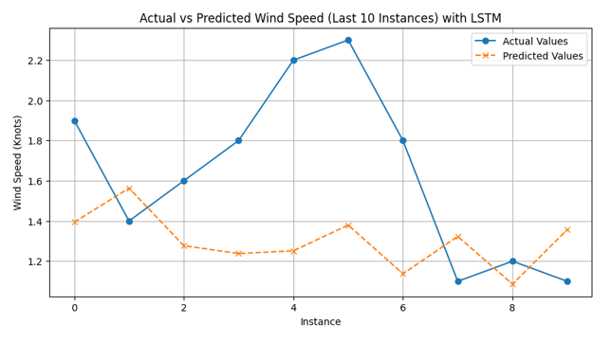
Methodology
Future Prediction
(LSTM)

Slide 14
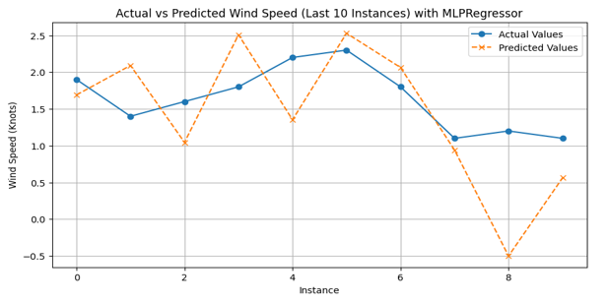
Methodology
Future Prediction
(RNN)

Slide 15
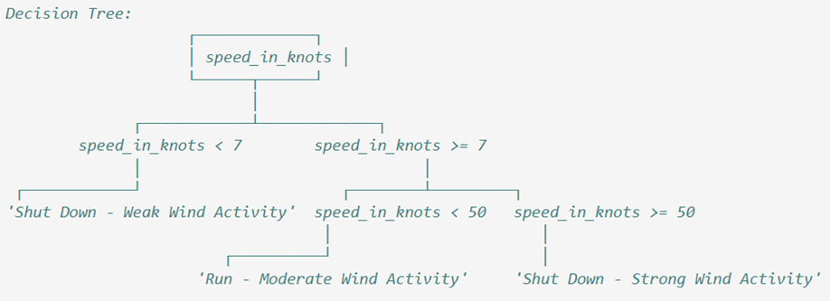
Methodology
Classification
Decision Tree algorithm is used to take wind turbine action:
  to maximize the efficiency
  to ensure the turbine safety

Slide 16
Conclusion
Conclusion
  Key Findings:
    Seasonal wind speed patterns observed
    MUT shows frequent peaks >3 knots; regional averages remain 1.5–2 knots.
  Model Performance:
    LSTM: MSE = 0.3017, R² = -0.9745.
    RNN: MSE = 1.918, R² = -0.7705.
    Highlights the challenge of accurate wind speed forecasting.
  Insights on Turbine Operation:
    MUT’s wind speeds (<7 knots) result in frequent turbine shutdowns.
    Current speeds are insufficient for economic wind energy generation.
  Conclusion:
    Calls for site-specific turbine technologies optimized for low wind speeds.
    Emphasizes the importance of tailored renewable energy strategies.

Slide 17

THANK
YOU

