Slide 1
Results on Climate Changing and Seasonal Precipitation Index
İ. SEZEN, B. EFE, A. TOKGÖZLÜ, Z. ASLAN,

Slide 2
Today, climate change is at the top of global problems. The adverse effects of climate change are predicted to primarily affect water resources, meteorological disasters, agriculture and food security, public health, land and marine ecosystems, and coastal areas. To adapt to changing climate conditions, it is first necessary to determine the effects of climate change, understand the impacts and adaptation processes, and assess them.
The last two decades have witnessed a growing water demand in developing countries. Drought has a substantial influence on water resources and irrigation. Three significant drought-type definitions are commonly used. And these are:
Meteorological Drought
Agricultural Drought
Hydrological Drought

Slide 3
Data
The data were obtained from the Regional Meteorology General Directorate and precipitation data between 1930 and 2023 were considered. Totally 93 years of data were used. 12-month data sets were pre-processed. These data sets are arranged according to the type of calculation.

Slide 4
Drought Indices
The Standard Precipitation Index (SPI). The World Meteorological Organization (WMO) recommends that all national meteorological and hydrological services should use dry spells. Some advantages of the SPI: It requires only monthly precipitation. It can be compared across regions with markedly different climates. The standardization of the SPI allows the index to determine the rarity of a current drought. It can be created for differing periods of 1-to-36 months. The SPI method is one of the most preferred methods in determining drought. In this index, developed by McKee et al. (1993), the average rainfall in a certain period (at least 30 years) is calculated by taking the actual precipitation difference and divided by the standard deviation of the rainfall in a certain period.

Slide 5

The magnitude of a drought event in a certain period (Drought Magnitude) is expressed by the following original formula:
In a drought assessment made taking into account the standardized Precipitation Index values, the time in which the index is constantly negative is defined as the dry period. The first month in which the index falls below zero is considered the beginning of the drought, while the month in which the index rises to a positive value is considered the end of the drought (McKee et al., 1994), (Table 1). Drought classification was made for these results and drought classification of Tsakiris and Vangel (2004) was taken into consideration for this.
These different types of droughts, the hydrological cycle, and also precipitation are the most important given the high dependence of many activities on surface water resources.

Slide 6
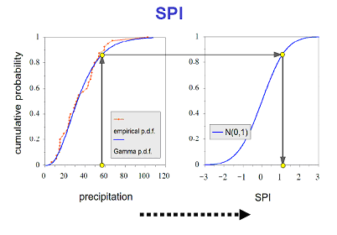

Slide 7
Table 1. Drought classification
Table 1. Drought classification
Meteorological Drought | SPI (1-3 months)
Agricultural Drought | SPI (6-9 months)
Hydrological Drought | SPI (12-24-48 months)

Slide 8
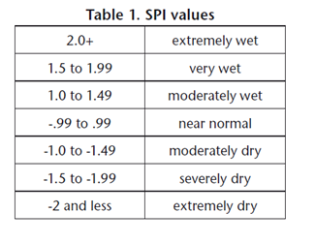
This paper covers drought classification after Tsakiris ve Vangel’in (2004),
(Table 2).
Table 2. Drought classification (Tsakiris ve Vangelis; 2004).

Slide 9
The reason why this index is frequently preferred is that it requires only long years of rainfall data and is easy to calculate. Many programs have been developed for the SPI method.
Evaluation for December: 27 years of additional rainy period between 1944-1971 (27); between 1971-2019 (48), 48 years of additional dry period prevailed. The very severe dry period (hydrological drought) between 1972-1975 (3), 2004-2008 (4), 2023 (1) has been effective for 8 years in 90 years in total. 5 years of severe drought, 9 years of moderate drought prevailed. After the temporal variation of rainfall, it shows that the dry period is observed after 1971.

Slide 10
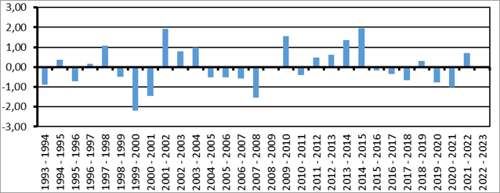
Fig.2. Isparta province 30-year SPI 12-month calculated values ​​Hydrological Drought

Slide 11
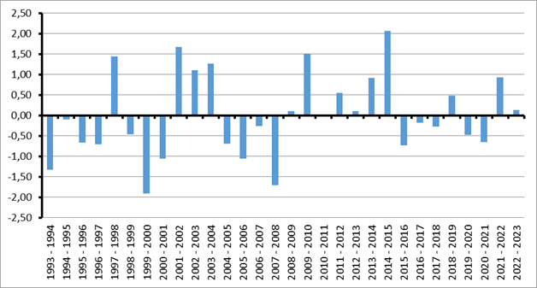
Fig. Isparta province 30-year SPI 9-month calculated values ​​Agricultural Drought

Slide 12
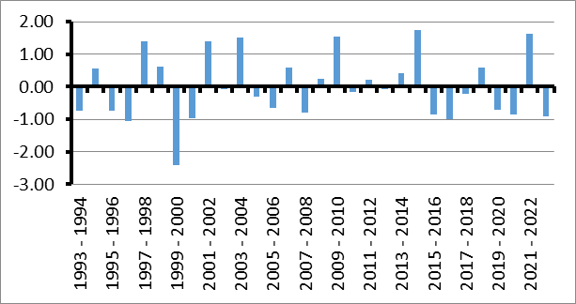
Fig. Isparta province 30-year SPI 6-month calculated values ​​Agricultural Drought

Slide 13
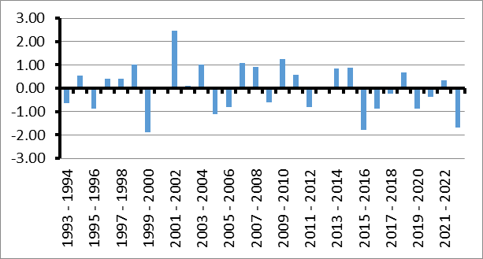
Fig. Isparta province 30-year SPI 3-month calculated values ​​of meteorological drought

Slide 14
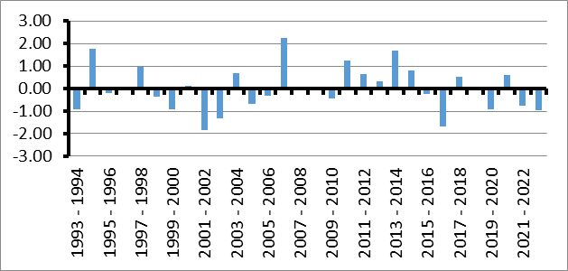
Fig. Isparta province 30-year SPI 1-month calculated values ​​of meteorological drought

